Slide 1

Childhood Begins at Home Budget Updates
April 23, 201
10:00-11:00am
Presented by
Sara Bradley, Learning Policy Director PA Partnerships for Children
Rosemarie Halt Senior Director of Policy Maternity Care Coalition
Karen Shanoski, State Office Director PA Parents as Teachers

Slide 2

Evidence-Based Home Visitation
Child Care
Early Intervention
Pre-K
Notes:
MISSION
Early Learning PA’s mission is to secure, by 2020, adequate resources to ensure all Pennsylvania’s children and families have access to voluntary, high-quality early learning opportunities that capitalize on a child’s most rapid period of brain development – birth to age 5.

Slide 3
2014-15
HV Subcommittee begins Strategy for PRR
2015-16
HV Subcommittee Joint Advocacy Campaign
2018
Childhood Begins at Home CampaignLaunched
Notes:
Pennsylvania needs to make stronger investments in high-quality early learning programs if it wants to reap the full social and economic benefits of these proven programs. Early Learning PA (ELPA) is a broad-based coalition that advocates access to voluntary, high-quality early learning opportunities for all Pennsylvania children. ELPA’s public policy agenda focuses on four key components of early learning opportunities: pre-kindergarten, child care, home visitation, and early intervention

Slide 4










Governing Committee 2018-2019
Notes:
The Governing Committee has expanded to include programs and critical advocacy partners across the state that are working hard to ensure that the importance of evidenced based home visiting is conveyed to the community and policy makers

Slide 5





Current Childhood Begins at Home Evidence-Based Programs
Evidence-based home visiting is a research-proven tool to support the development and safety of our most vulnerable children and their families
Notes:
Early Head Start (EHS) - Enhances the ability of low-income families to meet the developmental and early learning needs of their children at home.
Healthy Families America (HFA) - Strengthens families by promoting positive parenting, enhancing child health and development, and preventing child abuse and neglect.
Nurse-Family Partnership (NFP) - Pairs first-time, low-income pregnant women with nurses to improve pregnancy/birth outcomes, child health and development, and family economic self-sufficiency.
Parents as Teachers (PAT) - Builds the capacity of parents to care for their children, while promoting school readiness and healthy child development
Family Check Up- Recently added, Family Check Up supports strategies to better engage parents and parent centered intervention for reducing problem behaviors in children from toddlers through adolescence.
Supported by the Childhood Begins at Home campaign. The Governing Body members include Allegheny County Family Support, Allies for Children, Fight Crime: Invest in Kids, Maternity Care Coalition, Pennsylvania Head Start Association, Pennsylvania Nurse-Family Partnership, Pennsylvania Parents as Teachers, Pennsylvania Partnerships for Children, and Trying Together

Slide 6
Strong Families, Strong Kids
Notes:
When the Childhood Begins at Home campaign launched there were 4 evidence-based home visiting programs being publicly funded by OCDEL. Since the launch of the campaign in 2017 an additional 2 programs have been funded by OCDEL and we anticipate that additional programs will receive their confirmation they are eligible to receive public funds from Pennsylvania. Currently, the now 6, publicly funded programs have a large range of eligibility requirements ranging from 130% of the Federal Poverty Guidelines ($32,630 annually for a family of 4) in Early Head Start to no income restrictions in the Parents as Teachers program. Under these conditions showcasing un-met need for policymakers using a wide range of income variables became increasingly difficult. The coalition decided to use to low income measure of 200% of Federal Poverty Guidelines ($50,200 for a family of 4) because although there is a program with no income limitation funds for program implementation are always limited. Programs strategically use funds for families who have the greatest risk factors. The National Center for Children and Poverty showcases that children that live in families under 200% of the Federal Poverty Guidelines are considered economically at risk which could result in poor health, school, and developmental outcomes for the child.

Slide 7

The 2019 Campaign Goals
Expand state investment to $25 million in the Community Based-Family Centers line within the Department of Human Services budget to serve an additional 5,000 families
Preserve current funding levels in the Nurse-Family Partnership line and in the Community Based-Family Centers line within the Department of Human Services budget.
Notes:
Build upon the commonwealth’s recently expanded state investments in evidence-based home visiting by allocating an additional $25 million in the Community Based-Family Centers line within the Department of Human Services budget to serve a greater proportion of pregnant women, young children and families eligible for evidence-based home visiting services.
Preserve current funding levels in the Nurse-Family Partnership line and in the Community Based-Family Centers line within the Department of Human Services budget allocated to support Parents as Teachers (PAT).
The original ask to the Governor’s Office was for a $25M increase for home visiting which would have resulted in an additional 5,000 children/families being served across the Commonwealth. We do understand the Governor has taken a firm stand on no large revenue increases this year. However, knowing the legislature, department heads, and Governor are all supportive of the impact evidence-based home visiting can provide it is essential that additional funding, when available, be allocated towards publicly funded home visiting programs.

Slide 8
Governors Proposed Budget Address
Governor Wolf proposed an additional $5 million for home visiting programs.
Since 2015 Pennsylvania has increased investment by $15 million!
Notes:
The Governor’s proposal of $5M additional dollars for home visiting states an additional 800 families will be served. That results in a breakdown of $6250 per child/family. Currently the dollars will be used for expansion of currently funded programs since procurement of home visiting program is not scheduled to happen until next year.

Slide 9
Making the Case for Evidence-Based Home Visiting
Advocacy
Build awareness of EBHV
Describe impact of services
Discuss the policy issues (access to services; need for public investments)
Lobbying
Influence to take a specific action on specific legislation

Slide 10
Opportunities to Use Your Voice
Coordinate with your Model State Office or Lead Agency
Champion & Legislator Visits
Support Families Voices
Communication Strategies
Cultivate Community Partnerships
Endorse the Campaign!

Slide 11
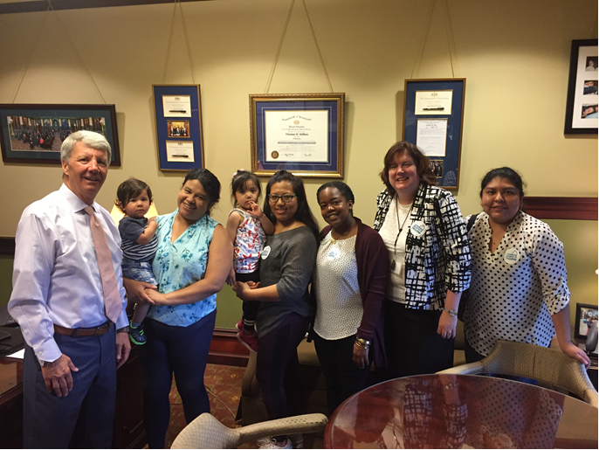
Champion and Legislator Visits
Work with local EBHV models as partners.
Host an event for champions and legislators.
Visit with legislators in Harrisburg.
  Brief EBHV & model information
  Short parent/family impact story

Slide 12

Communication Strategies
Use media and social media to promote EBHV.
  Send newsletters and social media posts
Videos
  Create mini videos to tell story for social media
Letters/Op-Ed for print publications and blogs
  Describe value of EBHV on family and community
Encourage Campaign endorsement
  Share website
  https://www.childhoodbeginsathome.org/

Slide 13
Supporting Families to Speak for Themselves
Provide Guidance & Preparation
Encourage Family participation
Being There
Successful Communication!
Notes:
KS
Value of family to describe impact and essentially---the return on investment
Ask family members who participate in services to explain the positive impact of EBHV
Respect family’s boundaries
Offer guidance in preparation of presentation and/or speaking points.
Clear, concise, convincing
Explain what to expect in different environments.
Roundtable, program site visits, champion or legislative visits
Prepare person for responding to questions.
Be there with them.

Slide 14
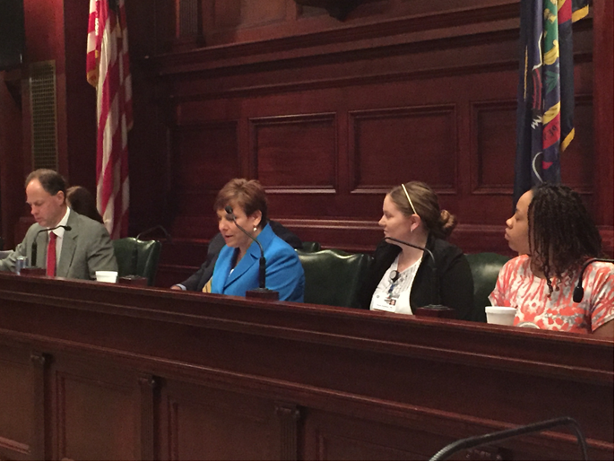
Cultivating Community Champions
Connect with influential leaders in your community who may become champions
Meet with legislators and staff regularly
Encourage community partners to describe their support and join the Campaign
Invite to participate in events
Share newsletter, announcements and social media postings

Slide 15
Questions?
Name of Program | Governing Board Representation | Email Contact
Family Check Up | Amy Malen | Amy.Malen@AlleghenyCounty.us
Parents as Teachers | Karen Shanoski | KShanoski@csc.csiu.org
Nurse-Family Partnership | Jessica Lipper | Jessica.Lipper@nursefamilyparternship.org
Healthy Family America | Rosemarie Halt | RHalt@maternitycarecoalition.org
Early Head Start | Blair Hyatt | Blair@PaHeadStart.org
Safe Care- Augmented | Carlene Nicholas | Cnicholas@outreachworks.org
e

Slide 16


Childhood Begin at Home
@ChildBegin_Home

